Slide 1
ROCKET: RObust Concept and Knowledge Extraction from Text
SDA
Shi Yu, Glenn Fung August 2016

Slide 2
Outlook
Brief Intro to AmFam and SDA
Background / Motivation
Potential Business Value
Relevant Data: Text in AmFam
Overview of ROCKET
Active learning
Predictive model development
Modeling techniques
Use-case: Internet search in the claim process

Slide 3
About American Family Insurance (AmFam)
Madison, Wisconsin – based American Family Insurance is the nation's third-largest mutual property/casualty insurance company and ranks 332th on the Fortune 500 list.
The company sells American Family-brand products, including auto, homeowners, life, business and farm/ranch insurance, through its exclusive agents in 19 states.
American Family affiliates (The General, Homesite and AssureStart) also provide options for consumers who want to manage their insurance matters directly over the Internet or by phone.

Slide 4
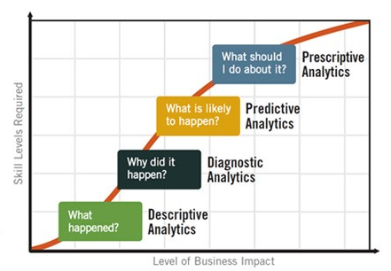
SDA – Providing Cutting Edge Analytics
In order to accelerate advancement of big data analytics capabilities and business transformation, AmFAM created a center of excellence for predictive analytics
Strategic Data & Analytics
Vision
Mission
To be the advanced analytics organizational champion, supporting the organization in becoming a superior analytic competitor.
To create competitive advantage and economic value by bringing together data innovation, advanced analytics and business acumen to optimize or transform our business models.

Slide 5
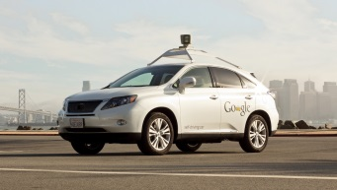
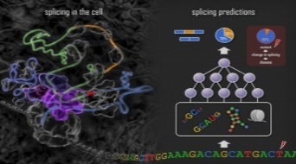
Machine Learning inside SDA
Machine Learning (ML)
What is ML? ML SDA Team Key ML applications in SDA
“Machine learning is the modern science of finding patterns and making predictions from data based on work in multivariate statistics, data mining, pattern recognition, and advanced/predictive analytics.”
ML techniques are the core technologies behind :
We SDA have a world-class team with the following (ML) expertise:
Natural language processing
Advance modeling: Random forests, SVMs, etc.
Probabilistic graphical models and Bayesian techniques
Deep learning
Big data – parallel processing
Customer satisfaction, Subrogation, Total loss:
Advanced modeling
Text analytics
Temporal mining
Recommender system for insurance :
Collaborative filtering
Bayesian networks
Low-rank matrix factorizations
Text score for claim notes:
Sentiment analysis
Big data: 145MM notes
Advance modelling (Multiple instance learning)
Customer Speech Sentiment analysis:
Signal processing
Speech-to-text conversion
Fraud detection, Roof classification:
Image processing
Deep learning
Self-driving cars
Smart web search
Genome discovery
Speech recognition

Slide 6
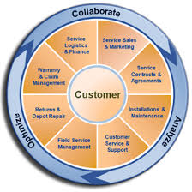
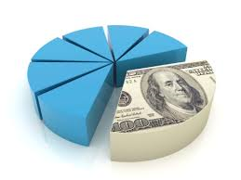
Analytics Applications in Insurance
With the complex nature of insurance risk exposures, and deep customer service interactions, insurance offers rich opportunities for advanced analytics
Customer & Marketing | Risk | Operations | Financial
Customer experience & behavior Propensity Product Affinity Retention & conversion Lifetime value | Pricing Underwriting Catastrophe modeling Claims severity & Fraud Reserving Product Design | Sales, UW & Claims operational performance HR – Employee Engagement attraction & retention | Portfolio optimization Financial modeling/ forecasting Economic modeling
CUSTOMER

Slide 7
Knowledge Extraction from Text (I)
“A fundamental task in text analysis is to ascertain or infer that a piece of text (a sentence, passage, or document) refers to a particular, given topic or concept.”*
*Automated Identification of Medical Concepts and Assertions in Medical Text
Rómer Rosales, Faisal Farooq, Balaji Krishnapuram, Shipeng Yu, and Glenn Fung

Slide 8
Knowledge Extraction from Text (II)
The topic can vary widely; for example we can assert if there is evidence that a party was interested in a rental car after reporting the loss:
ERIC CALLED ME AND WANTS RENTAL… can be accepted as a statement of the fact that ERIN (A party in the claim) is interested in a rental
A similar task is to determine the polarity of the text; that is, whether the piece of text represents positive or negative evidence about the topic. For example:
The insured reported a neck injury clearly provides positive evidence about a neck injury, while The insured does not seems to have any significant injuries provides negative evidence about any injury type (neck injury in this case).

Slide 9
Examples of use-cases for AmFam
Use-cases for the insurance domain
Entity extraction from unstructured text
Places, people names, roles (insured, lawyer, claimant, etc.), dollar amounts
To detect predefined relations among entities
Does this Phone number belong to this lawyer?
Is Pedro Jones a Doctor?
Relevance of a concept or question:
Is there evidence in this claim note that this person had a neck injury?
Is this claim related to wind or hail?

Slide 10
Business Value of the Technology (some examples)
Unstructured data sources processing and model-ready structural data preparation
Complex sentiment and emotion analysis
To detect specific concerns expressed by customer in social media
Provide recommendations by detecting actionable events from unstructured data: calls transcripts, emails, notes
Reduce intensive manual labor
Brand reputation monitoring
Improve customer
satisfaction
Better customer experience
and improved information for
Upsell / cross-sell

Slide 11
Description of relevant data: Text in AmFam
Unstructured data is ubiquitous inside AmFam:
Claims notes (160MM+) notes available
Touchpoint (claim survey) comments
FNOL (first notice of loss) descriptions
Social media feeds (Sysomos, Networked Insights)
Call transcriptions (voci)
Code, project charters, documentations, emails, etc.

Slide 12
Overview of the ROCKET framework
Identify concept of interest
Input concept to be extracted
Enrich concept
Word2vec, business expertise
Generate candidate occurrences
of concept
SQL, Regexp, Elasticsearch
Create text features
N-grams,word2vec,stanford CoreNLP
Positional features, etc.
Optimally label a small subset
of candidates
Active learning, Crowdsourcing
Generate models
SVMs, Deep learning

Slide 13
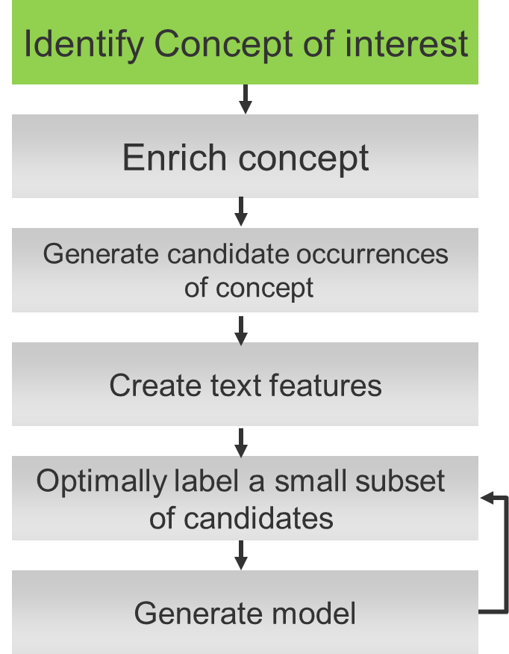
Define / Identify Concept
This is the initial input to the framework
Consists in defining the concept to be extracted
We will use the following example for the rest of
The presentation: We want to find notes that are relevant
to the concept of neck injury
Concept terms set = {neck,injury}

Slide 14
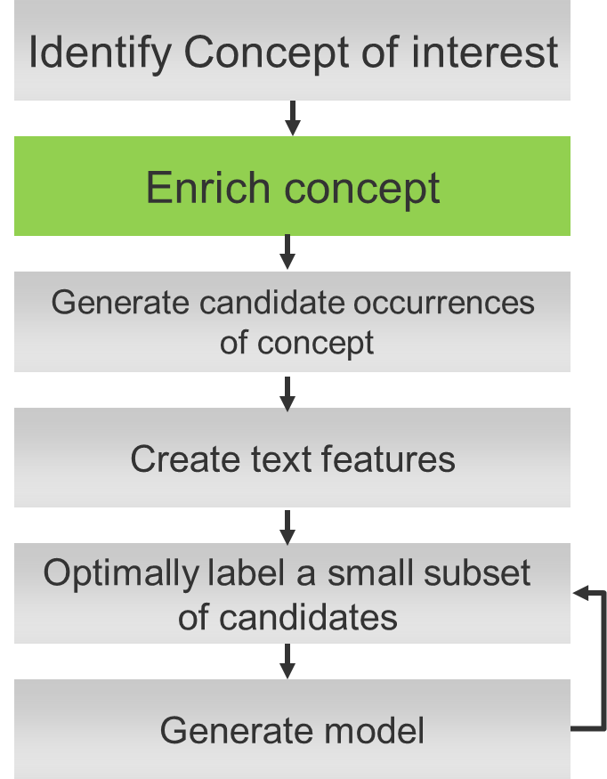
Using Word2vec to expand Concepts
Concept terms set={neck, injury}
Word2vec, business expertise
Expanded concept terms set
{neck, injury, pain, lesion, cervix, whiplash, stiff, spine}

Slide 15
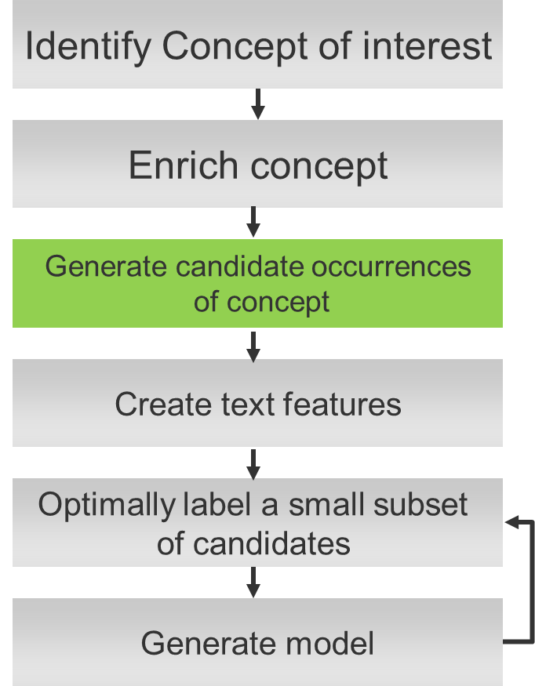
Candidate Generation
160MM claim notes
Note that not all notes are relevant to Neck injury!
Example:
“The insured say that the Last time he saw the collar was in his
wife neck”
Here we want maximum
Recall!
SQL,Regexp,Elasticsearch
10K notes that contain the
concept terms
{neck, injury, pain, lesion, cervix, whiplash, stiff, spine}

Slide 16
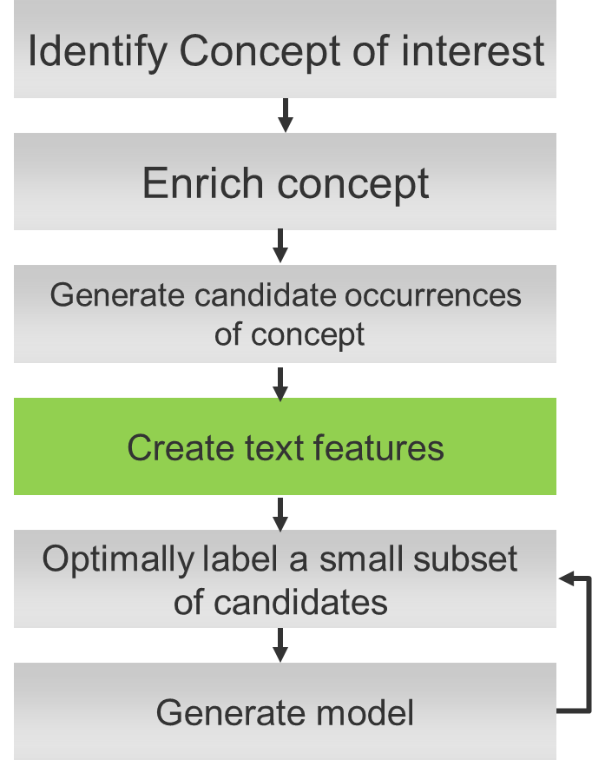
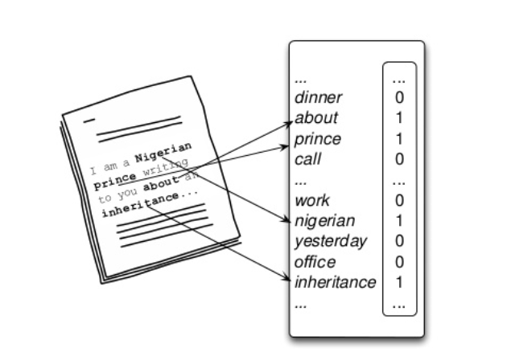
Using NLP for Feature Generation
In this step we use NLP different techniques to represent each one of the 10k candidates as a vector
N-grams: the basic bag of word representation
Word2vec: we can use this to map similar terms to the same vector position to improve generalization e.g.: policyholder → driver / enterprise
NER to recognize people names, places, dates, etc.
Spatial features to measure the relative position of every word to the concept terms.

Slide 17
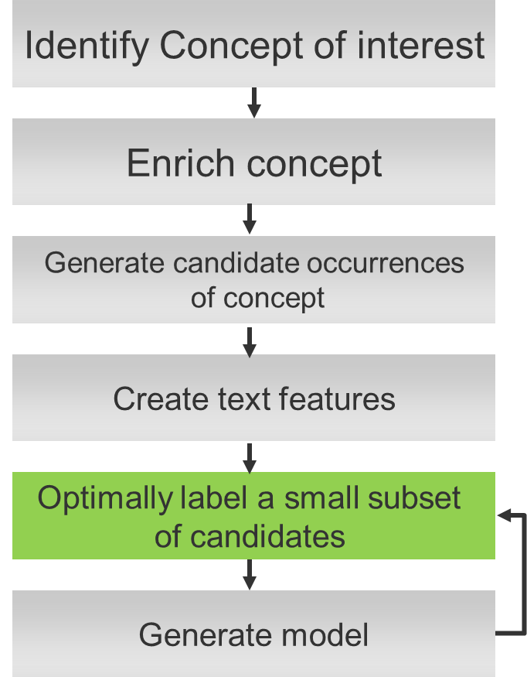
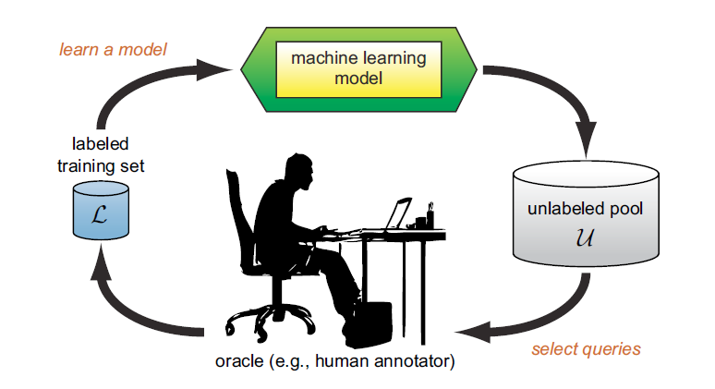
Using Active Learning to optimally label data
Difficult and time-consuming to label all the data manually
Adaptive learning paradigm for optimal labelling
Manually label first k text examples
Learn model, score it on all the unlabeled candidates
Pick the best next k candidates to label
Repeat the two previous steps until performance converges
We will leverage the NEXT
Crowdsourcing / Active Learning
platform from the UW

Slide 18
Active Learning
Instead of having annotators label all the training data, we would like to intelligently choose instances to be labeled -- called active learning.

Slide 19
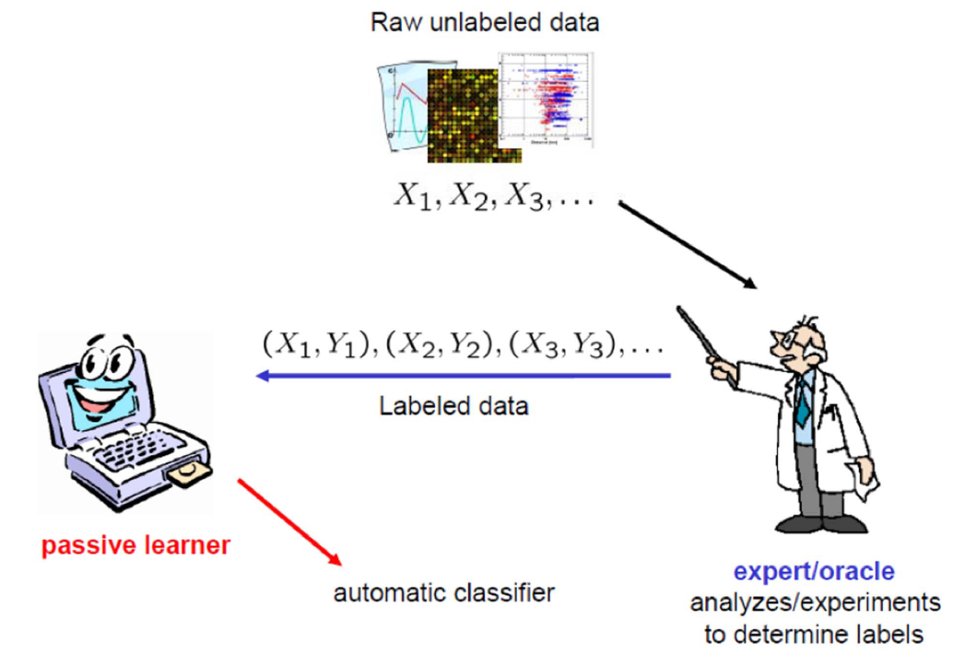
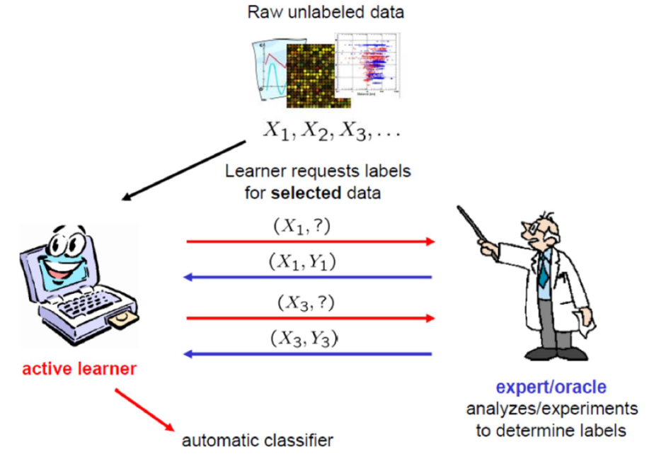
Passive Learning vs. Active Learning
Standard supervised learning
Active learning
Taken from Prof. Yi Zhan lectures

Slide 20
What is NEXT?
“NEXT is a machine learning system that runs in the cloud and makes it easy to develop, evaluate, and apply active learning in the real-world.”
http://nextml.org/
Source: https://github.com/nextml/next/

Slide 21
NEXT
NEXT provides the architecture to enrich machine-learning with human feedback
Local Database
Data Manager
Experiment
Hadoop
API
User Interface
Algorithms
Spark
Algorithm
Manager
NEXT is open-source, integrates with our existing code, and can scale to our needs

Slide 22
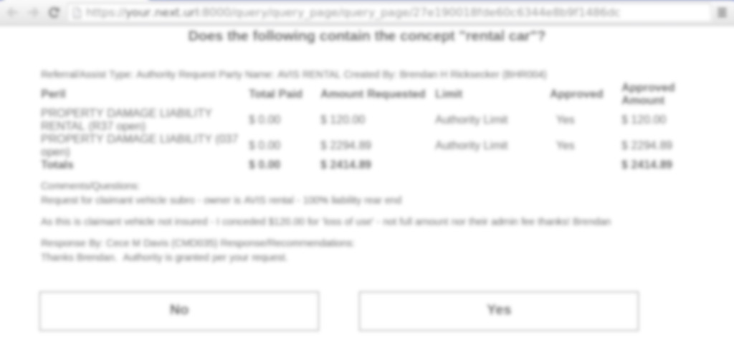
NEXT
NEXT starts a server and provides a URL to send to users to crowdsource data:
Is this document relevant to car rental?
NEXT automatically processes the answers and updates the algorithms

Slide 23
NEXT
NEXT provides real-time diagnostics and performance data via customizable dashboards

Slide 24
NEXT
NEXT can be used anywhere where human feedback is needed in machine learning:
Semi-supervised and supervised machine learning
Text mining, image processing, speech recognition
Acquiring labels for unlabeled data
Running multiple algorithms in parallel to compare performance
Evaluating and validating existing models

Slide 25
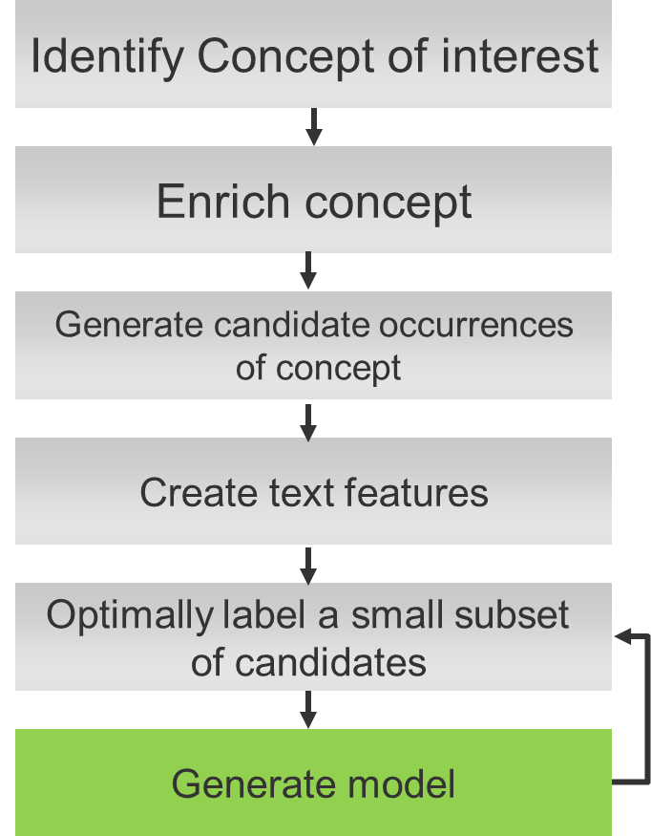
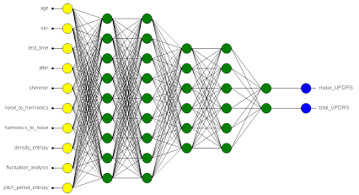
Classifiers
For the active learning process it is preferable to consider models that:
Can be trained in a fast manner to reduce waiting time for human feedback (labeling)
Can be retrained in an incremental fashion since the labeled data set grows incrementally (updating)
We consider several models (Logistic Regression, SVMs, LS-SVMS, Random forest, Bayesian approaches) for the AL loop.
Once the AL loop converges a final model we will consider
more complex models such as deep learning, semi-supervised approaches.

Slide 26
Use-case: Using claims-related concepts for insurance predictive models
Concept 1
Concept 2
Concept 3
Model features
Concept features
+
Structured data features
Yes / No
#1
Predictive model
#2
Explanations
Flagged Claims

Slide 27
Examples for Internet research
Examples from the “Car Rental” concept
True negatives
Payment Instructions: 00/022025/$500 ded/driver side front and rear door/rental:30/750/no lien
CONTACT: Insured Luisa B reported fnol from (xxx) xxx-xxxx . Claim acknowledged Advised contact 1-2 business days FACTS OF LOSS: Three car accident insured was middle vehicle and was pushed into claimant vehicle in front. Insured explained she was stopped in traffic when claim behind hit her. REPAIR OPTIONS: Vehicle is located at Tow Yard sending PD adj APO insured plans to have claimant carrier handle repairs and rental RENTAL: N/A CLAIM PROCESS: Explained coverages with AMFAM. OTHER PERTINENT INFORMATION: You have the legal right to choose a repair shop to fix your vehicle. Your policy will cover the reasonable costs of repairing your vehicle to its pre-accident condition no matter where you have the repairs made
Insured called in claim from cell: XXX-XXX-XXXX (only number for insured). Insured pulled out in front of claimant in intersection. Date of Loss: 12/18/2010 @ 10:37am. Location: 15th Street And XXX Street - Hannibal MO. Hannibal Police report #XXXX-XXXX. No claimant info known. Insured driver: XXXX XXXXX (00) 00 driving the 2004 Buick Century Custom. Damage: passenger fender and front bumper headlight smashed in hood pushed over passenger front door does not open properly. Color: light brown. Mileage is approx. 78k. MO plate #XXXX. VEA: 10 points. Insured has estimates from Hannibal Paint & Body for $2898.32 and from Gibbon's B/S for $2603.80. Insured would like to use Gibbon's. Advised due to amount of damage PD inspection is needed. Explained process. Offered rental advised it is available during the repairs. Insured declined stating she is now nervous to drive and would rather not have rental. Advised if she changes her mind it will be available for her. Claims process explained.
Referral/Assist Type: General Party Name: XXXX XXX Created By: XXX A XXX (KXXXX) Comments/Questions: <p>ERIC CALLED ME AND WANTS RENTAL FROM BAUM - WAS SICK AND SHOP TOLD HER NOT TO BE DRIVING HER VEHICLE</p> '
True positives
Notes:
Example of

Slide 28
Conclusions
We have proposed a semi-automatic framework for robust concept extraction from text – ROCKET
ROCKET can be extended with few effort to perform specialized knowledge extraction in lots of analytical applications
Human interaction requires few or non training (depending on the concept to be learned)

Slide 29
BACK UP

